Slide 1

B.Tech Project Final Evaluation, VIIIth Sem
Preliminary Screening SECURITY, PRIVACY AND TRUST ISSUES IN IOT
Presented by :-
Ronika Shrestha 2019003290
Kanishka Negi 2019600654
Tanya Lillian Borges 2019639262
Under the Supervision of:-
Dr. Subrata Sahana
Sharda University,
Greater Noida
DEPARTMENT OF COMPUTER SCIENCE & ENGINEERING
SCHOOL OF ENGINEERING AND TECHNOLOGY
May 2023

Slide 2
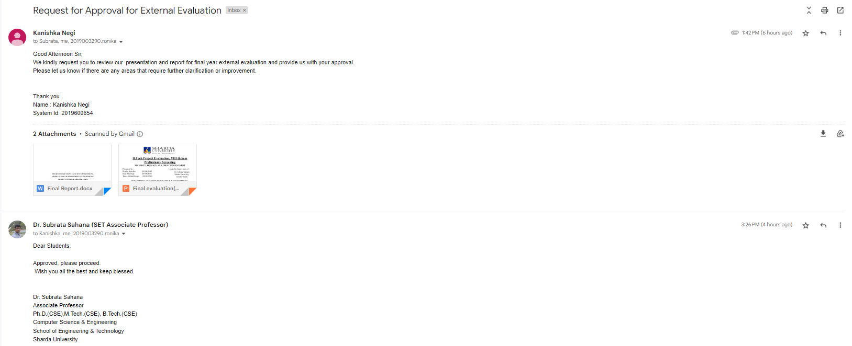
SCREENSHOT OF APPROVAL

Slide 3
CONTENTS
Introduction
Objective
Problem Statement
Methodology
Existing System Disadvantages
Implementation
Result
Why is AES+ECDH better for ESP 32?
Conclusion
References

Slide 4
INTRODUCTION
IoT device data is being stored and accessed via cloud storage [1], presenting security concerns for sensitive data transmission.
An ECDH [2] and AES-based [3] security paradigm is suggested for ESP32-based IoT devices using cloud storage to provide end-to-end encryption.
The suggested security model uses ECDH algorithm for secure key exchange and AES algorithm for data encryption, implemented on ESP32 microcontroller hardware platform.
The goal is to safeguard sensitive data from hacker assaults and unauthorised access for IoT devices that use ESP32 [4] for cloud storage, providing enhanced security for IoT applications.

Slide 5
OBJECTIVE
The project will focus on how to cipher data with AES-256 and ECDH, on the Arduino core running on the ESP32.
The purpose of this is to develop a mechanism that could make the data unreadable by unauthorized users using an encryption algorithm. It then would prevent precious data from being stolen by the attackers through network sniffing.
This project aims to provide and simulate an effective solution to face the challenges in storage of IoT data and solve security issues in cloud computation.

Slide 6
PROBLEM STATEMENT
IoT device data stored in the cloud. Security concerns with sensitive data transmission over the internet
Suggest ECDH and AES-based security for ESP32-based devices using cloud storage
ECDH algorithm used for secure key exchange, AES algorithm used for data encryption
ESP32 microcontroller used as hardware platform for implementation
The goal is to create effective security architecture to safeguard sensitive data for ESP32-based IoT devices using cloud storage
Aim to enable secure interaction between IoT and cloud storage servers, enhancing security for IoT applications.

Slide 7
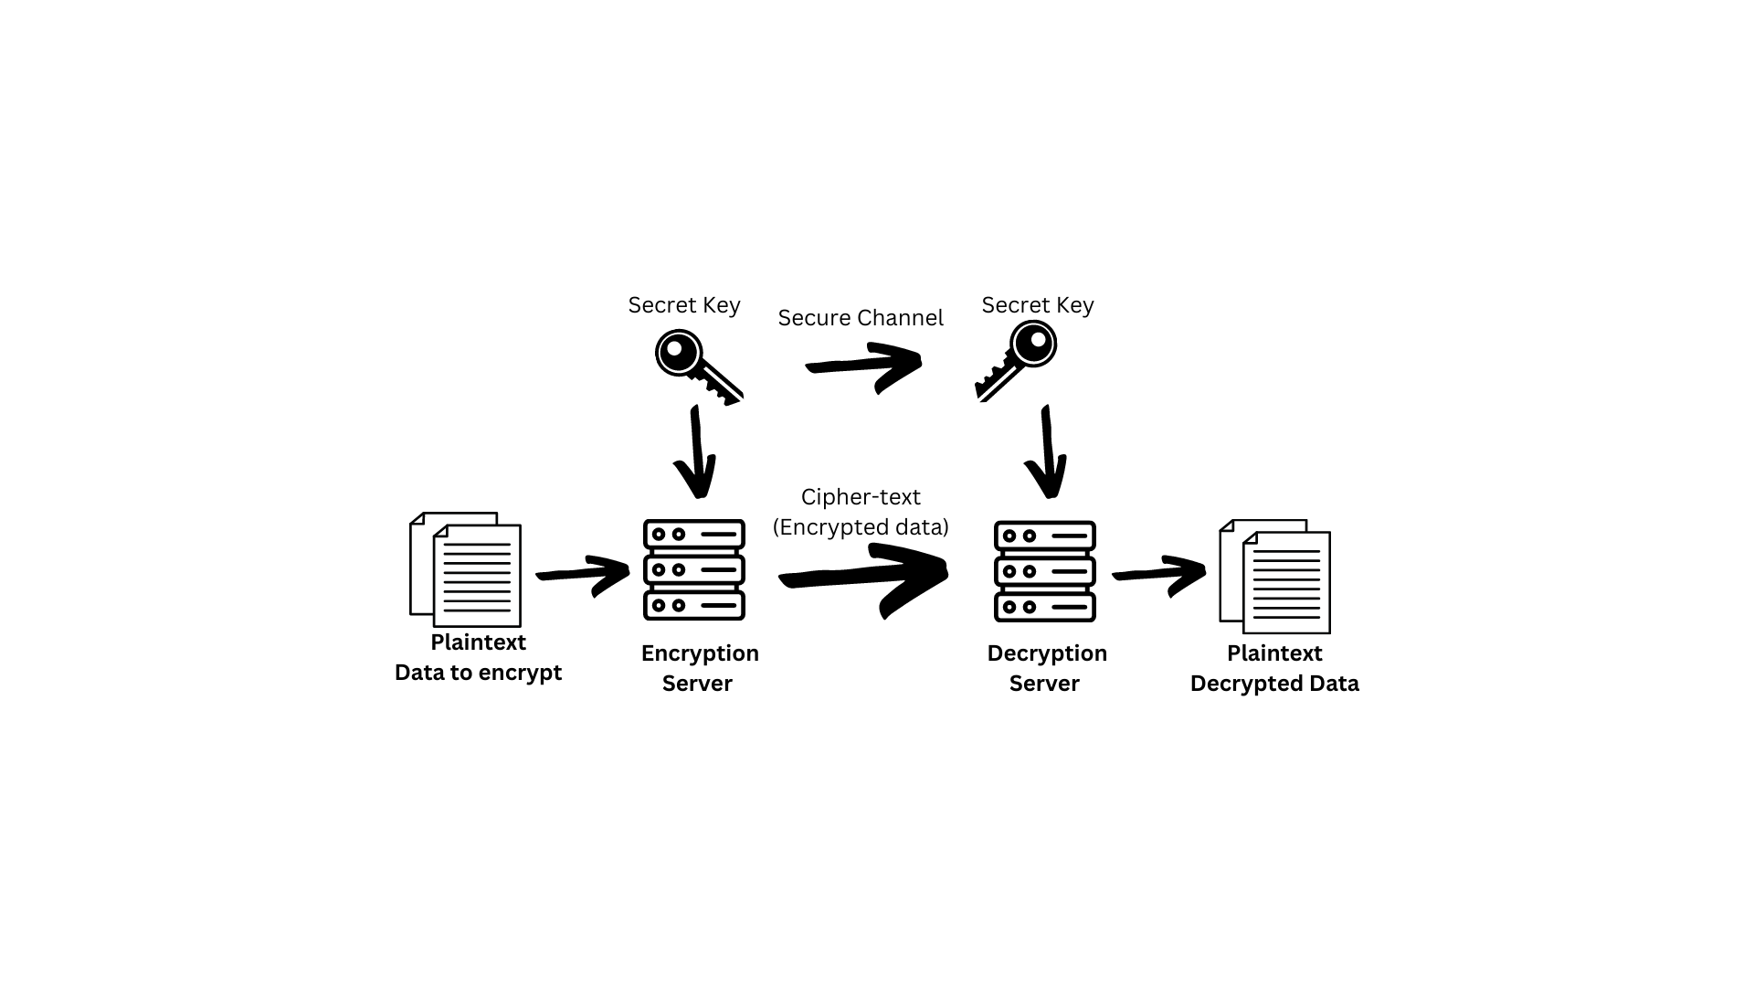
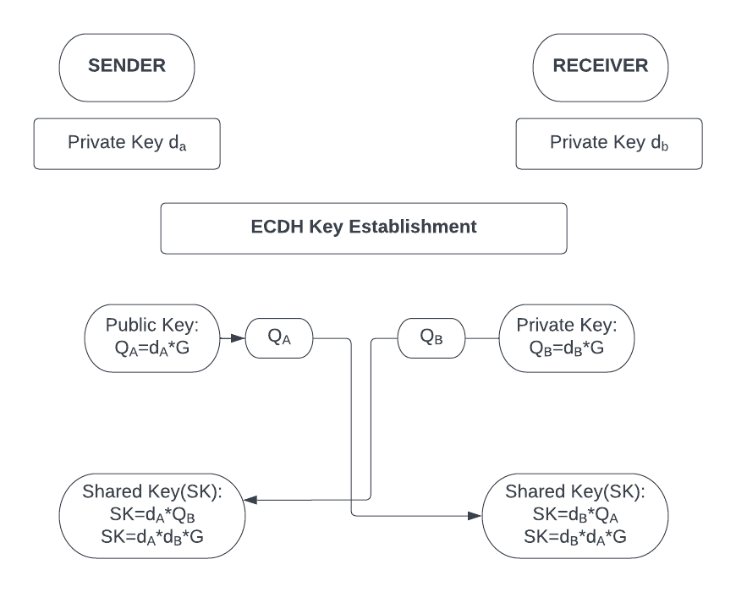
METHODOLOGY
Advanced Encryption Standard (AES)
It is a symmetric key encryption technique [3] used to safeguard and encrypt data saved on storage devices. A brief description of the working of AES is illustrated in the figure 1.
Elliptic Curve Diffie-Hellman (ECDH)
ECDH (Figure 2) is a protocol used for key exchange between two parties over an insecure communication channel [2]. It is based on ECC [5] and Diffie Hellman Key Exchange [6] and is regarded as one of the most secure key exchange protocols.
Figure 1: Working of AES
Figure 2 : Key Generation using ECDH

Slide 8
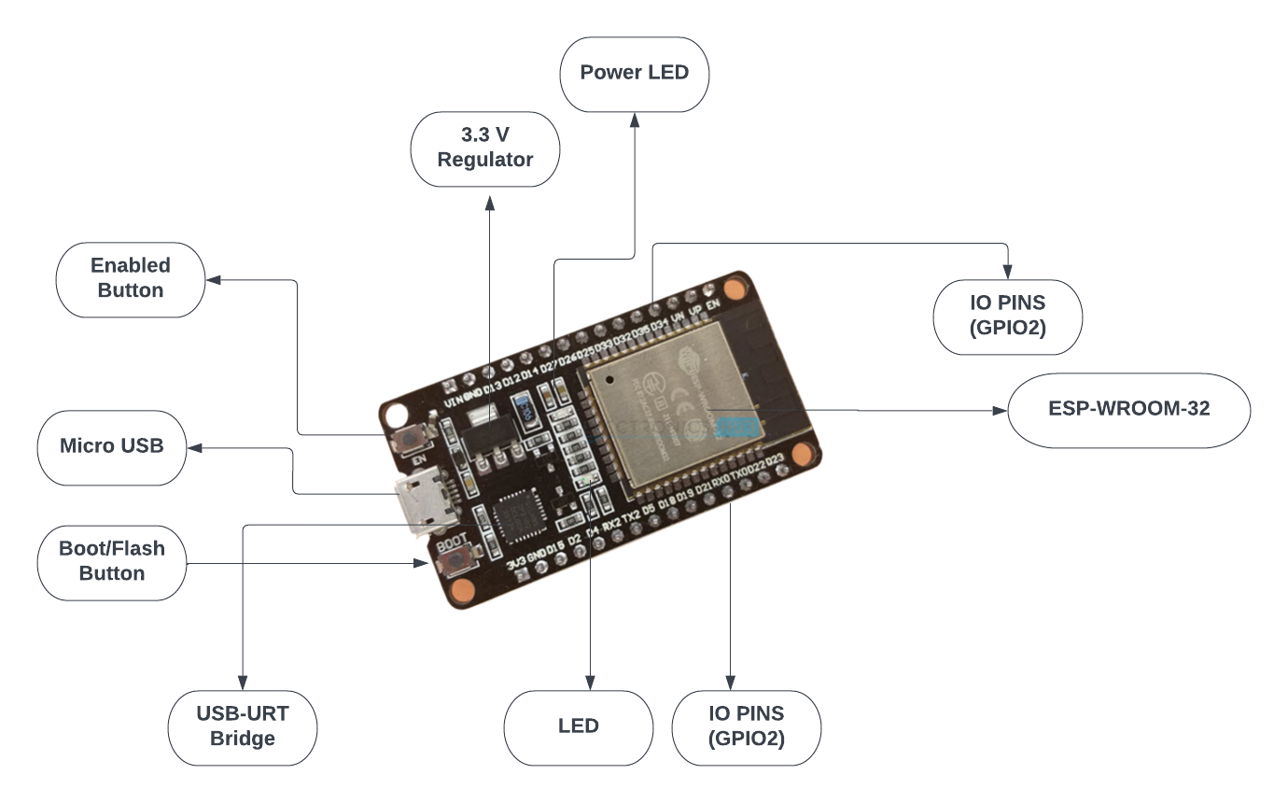
CONT.
ESP 32
A microcontroller board called the ESP32 [4] comes with a
dual-core processor, wireless connection, and a variety
of input/output options. It’s essential characteristics include:
CPU with two cores
Wi-Fi and Bluetooth are supported by the ESP32
Digital and analogue inputs and outputs
Low power consumption
ESP32 offers a strong and adaptable platform to create a variety of embedded systems. It is the perfect option for many applications thanks to its mix of high-performance computation, wireless connection, and low power consumption.
Figure 3: ESP32 Board

Slide 9
EXISTING SYSTEM DISADVANTAGES
Existing encryption solutions for ESP32 microcontrollers have the following drawbacks:
Impact on performance: Encryption techniques can severely impact speed and power consumption of ESP32, which affects the effectiveness and of the system.
Restricted key sizes: The small key sizes of many techniques used with ESP32 make them vulnerable to attacks.
Compatibility issues: Certain techniques may be incompatible with ESP32 limiting their use in some applications and making it challenging to find an appropriate solution.
Cost: Some models may require additional hardware or software, which increases the cost.
Overcoming these drawbacks is essential to create a security architecture for ESP32 and ESP8266 microcontrollers that can effectively protect sensitive data from hacker attacks and illegal access.

Slide 10
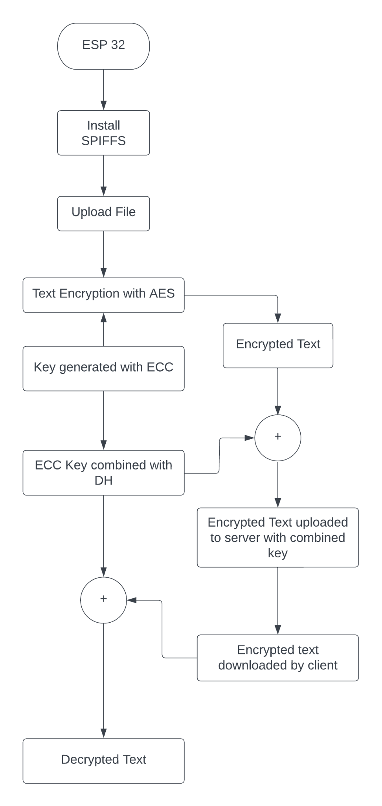
IMPLEMENTATION
To set up a file uploader system on ESP32, we need to download and set up the SPIFFS file system.
SPIFFS creates configuration files, saves data permanently, stores small amounts of data, and more.
After downloading SPIFFS, we customize configurations for uploading data to the ESP32 board.
ECDH is used to generate a shared secret key, following elliptic curve constraints thus resulting in a secure connection.
AES encrypts the input file using the shared secret key generated by ECDH, and the customer decrypts the encoded document using the same merged key to get the original file.
Figure 4: Representation Of ECDH and AES on ESP32

Slide 11
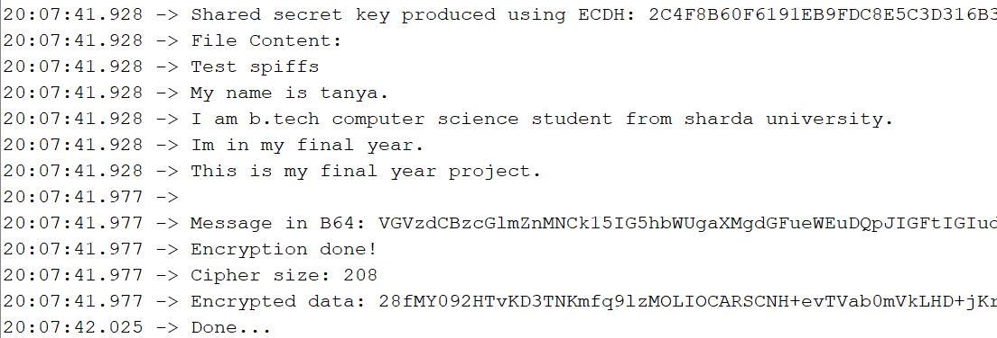
RESULT
Cloud storage is beneficial, but data security concerns that limit its adoption.
We propose a hybrid model that combines AES algorithm and ECDH to protect communication from external threats. This technique is secure and difficult to breach, and has a significant and superior impact over other algorithms.
Figure 5 shows the result of our proposed approach. It begins by generating the shared secret key using ECDH then the file is uploaded using SPIFFS and encrypted by AES.
Figure 5: Result of proposed approach

Slide 12
WHY IS AES+ECDH BETTER FOR ESP32
AES+ECDH is the combination of the AES algorithm and the ECDH key exchange. It provides better security than using either algorithm alone.
ECDH is used to generate a shared secret key that is then used by AES to encrypt data.
AES+ECDH provides a good balance between security and performance, making it a popular choice for encryption use cases.
While AES alone can be faster and more efficient for small amounts of data, AES+ECDH is preferred when transmitting data over an unsecured network.
Using ECDH to generate the key also allows for the use of smaller key sizes without compromising security, compared to other asymmetric encryption algorithms such as RSA.
The combination of AES and ECDH is widely used for providing both confidentiality and key agreement.

Slide 13
CONCLUSION
A hybrid model of AES and ECDH is suggested to protect communication from external threats on ESP32 and other microcontrollers.
The AES-ECDH hybrid technique is highly secure and difficult to breach, making it a suitable solution for ESP32-based IoT devices.
The hybrid model has a promising future scope in various industries where secure file transmission is crucial.
With a low encryption time of 1.02 milliseconds, the hybrid model is a viable solution for real-time file transmission on ESP32-based systems.
The hybrid model's superior security features ensure the privacy and security of transmitted files on ESP32-based systems.

Slide 14
REFERENCES
[1] Stergiou, C., Psannis, K. E., Kim, B.-G., & Gupta, B. (2018). Secure integration of IOT and cloud computing. Future Generation Computer Systems, 78, 964–975. https://doi.org/10.1016/j.future.2016.11.031
[2] Haakegaard, R., & Lang, J. (2015). The elliptic curve diffie-hellman (ecdh). Online at https://koclab. cs. ucsb.edu/teaching/ecc/project/2015Projects/Haakegaard+ Lang. pdf.
[3] Heron, S. (2009). Advanced encryption standard (AES). Network Security, 2009(12), 8-12.
[4] "The Internet of Things with ESP32", Esp32.net, 2019. [Online]. Available: http://esp32.net/.
[5] M. Amara and A. Siad, "Elliptic Curve Cryptography and its applications," International Workshop on Systems, Signal Processing and their Applications, WOSSPA, 2011, pp. 247-250, doi: 10.1109/WOSSPA.2011.5931464.
[6] Diffie, W. (1976). Diffie-Hellman Key Exchange.

Slide 15
THANK YOU

